Slide 1
Determining Basalts’ Tectonic Boundary Type Based on its Chemical Compositions Using a Machine Learning Algorithm
Jenifer Vivar
Karin Block
Michael Grossberg

Slide 2
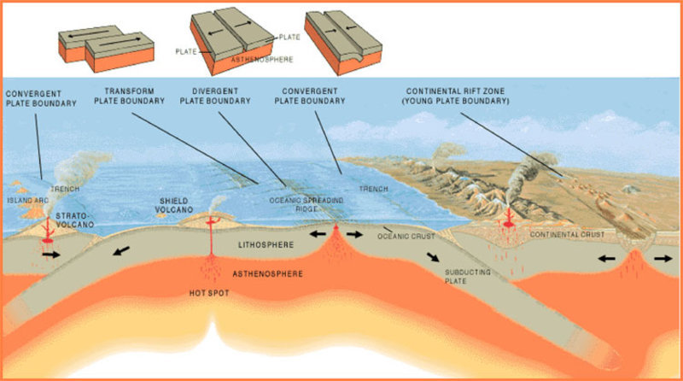
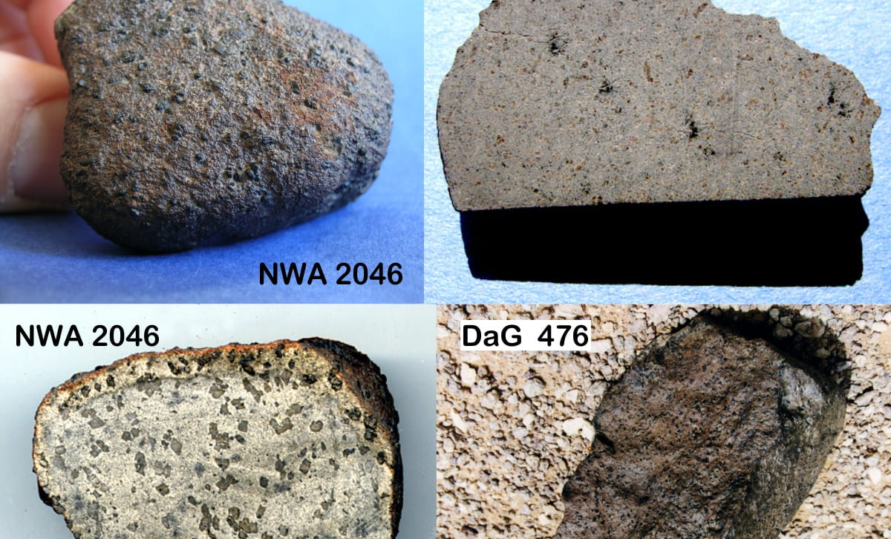
Basalts and Tectonic Boundaries
Basalts are rocks from rapid cooling of low-viscosity lava.
The Earth’s lithosphere is made up of tectonic plates that move slowly over time.

Slide 3
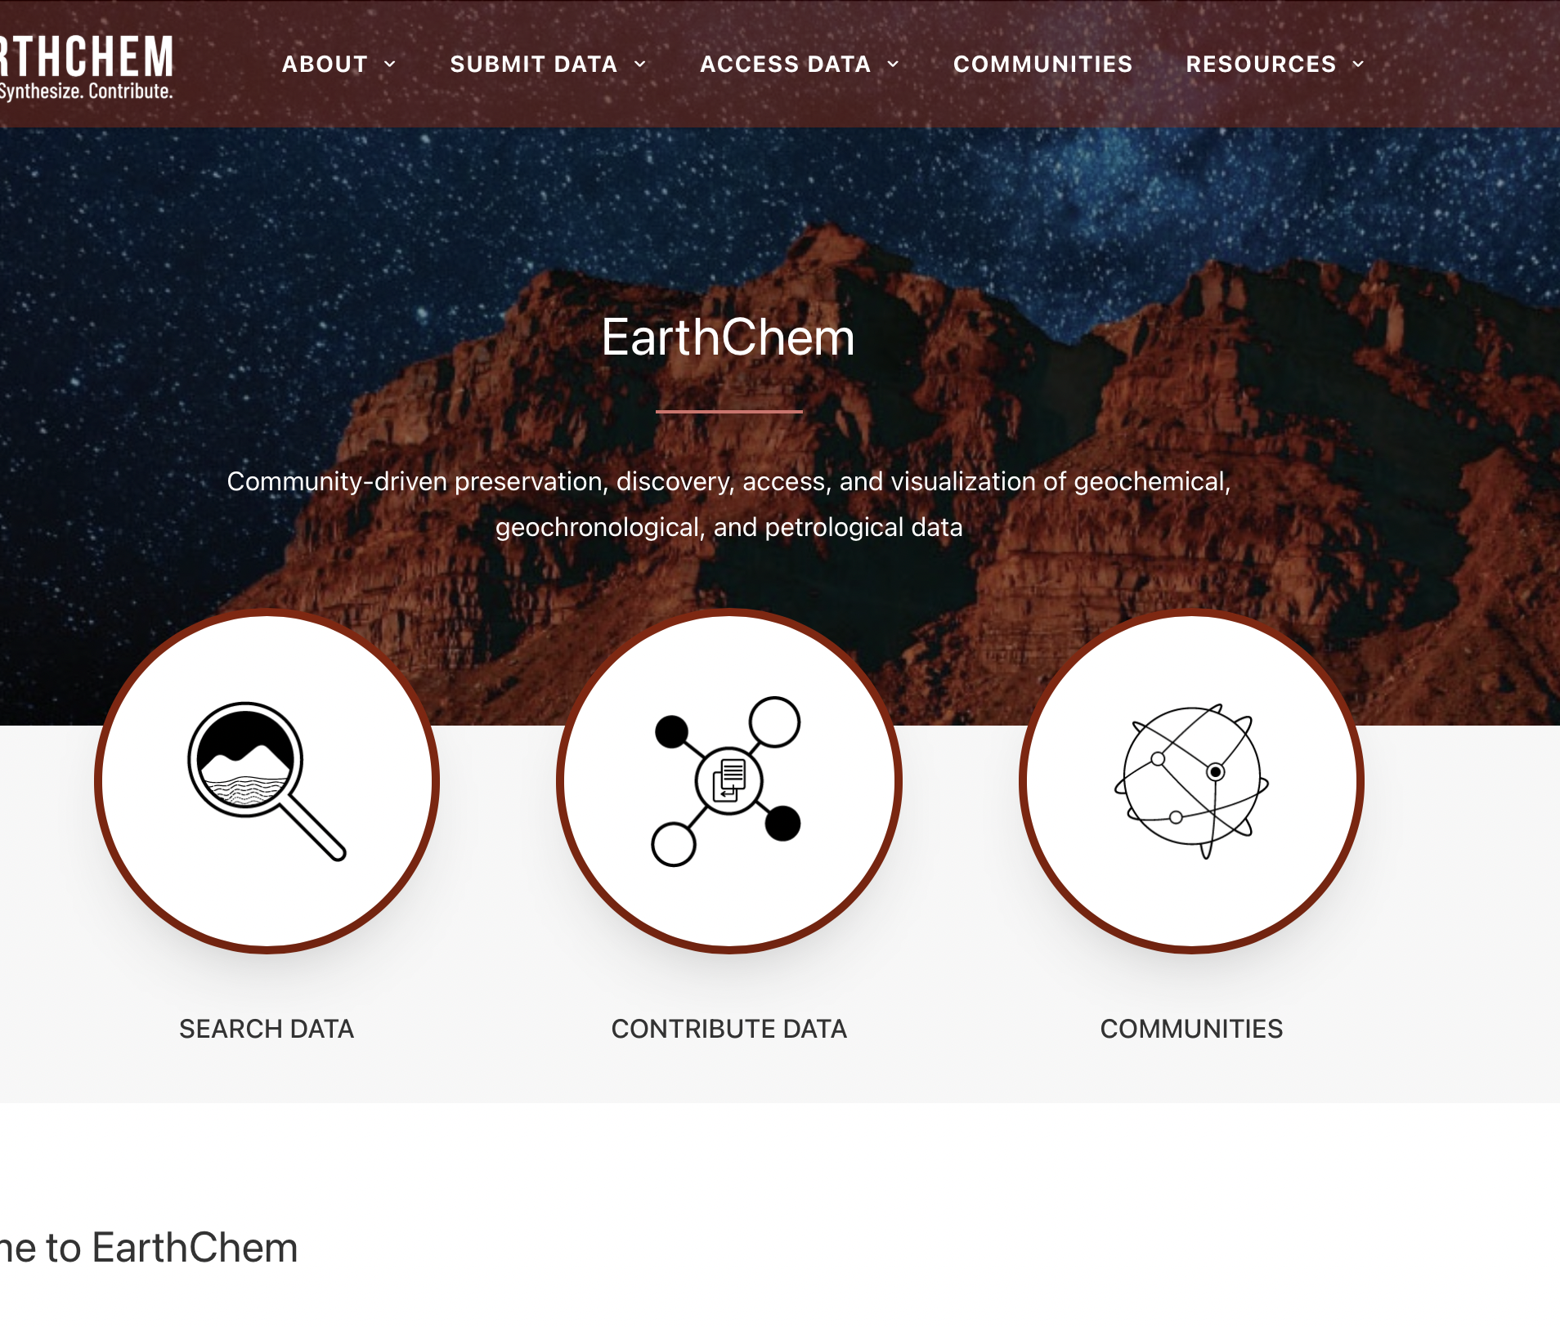
The Problem
The EarthChem database has a large basalt dataset that has been collected over the years from the peer-reviewed literature.
Many of this data has inconsistent labels.
No proper identification of the type of tectonic boundary
The data is large and there needs to be better way to identifying important features.
Identifying a tectonic boundary setting is costly and time consuming.

Slide 4
WHY
Could helps us identify and mitigate natural hazards such as earthquakes.
Can help scientist better understand the chemical composition of the mantle.
Can help predict the type of tectonic plate at a given location based on the chemical composition of the sample alone.

Slide 5
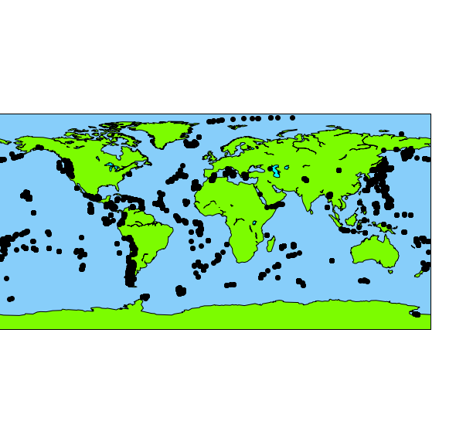
Labeled Data Source
The data being used for training was compiled by one researcher from the source databases served by Earthchem.org. Despite this, the data contains possible outliers and requires cleaning.

Slide 6
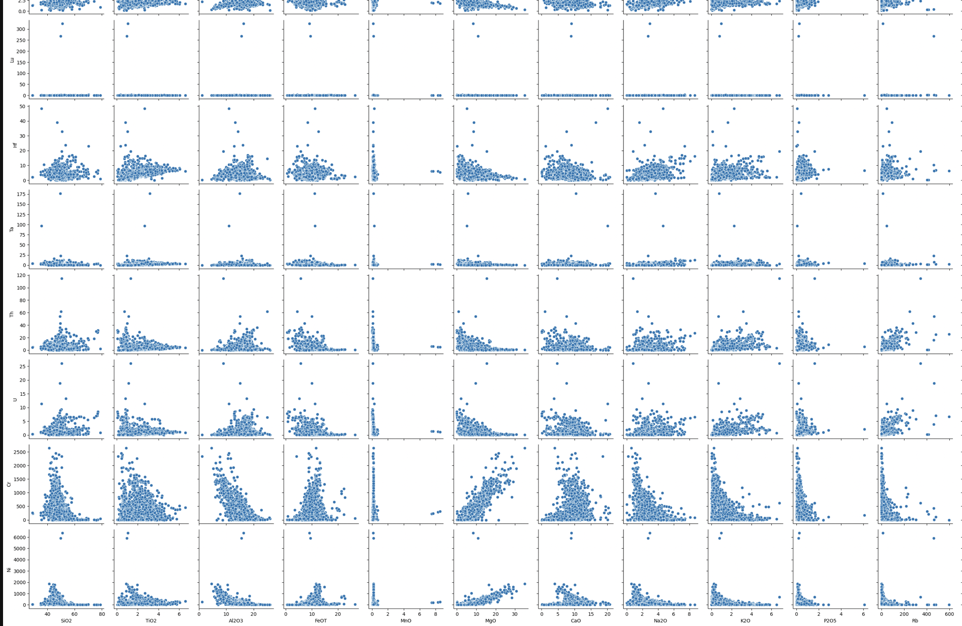

Outliers

Slide 7
How
Small portion of labeled data is being explore
The data is being cleaned and outliers are analyzed closely with the experts
Feature importance will explore to reduce memory usage for larger data sets
A regression model will be trained with the data
Other models, such as random forest, will be trained as well

Slide 8
How
Unlabeled data set will be compiled and cleaned (November – December 2022)
Data will be fed to the selected, best performing model, for prediction (January-February 2023)
Results will be carefully inspected using traditional methods with the help of geologist and experts
The code will be made publicly available via GitHub and used for geoscience workshop for student and researchers

